Slide 1



Hardware and Software Fundamentals of Intelligent Computing Systems

Slide 2
Lecture 45: Open-Source Contribution and Community Collaboration
How to Submit a PR to FlagOS, Code Standards, CI/CD Workflow

Slide 3
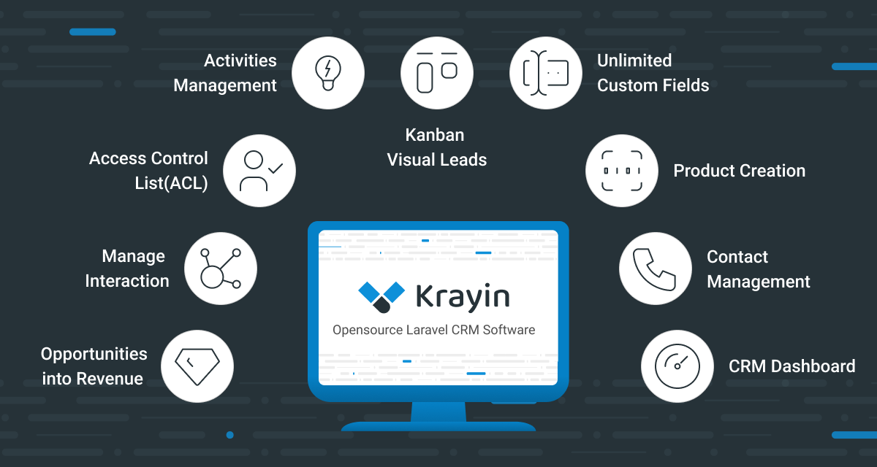
Open Source Community
Open Source Software
Promotes global developer collaboration through public source code — anyone can view, use, modify, and distribute the code
Collaboration Model
Developers worldwide can collaborate on projects, continuously improving software quality through code reviews and discussions
GitHub Platform
The most popular open source collaboration platform, offering code hosting, version control, issue tracking, and a complete Pull Request workflow
Image source: GitHub Topics
Open Source in AI
Core AI frameworks like PyTorch, TensorFlow, and Hugging Face all use open source models, driving rapid industry growth
Notes:
单击此处添加文本

Slide 4
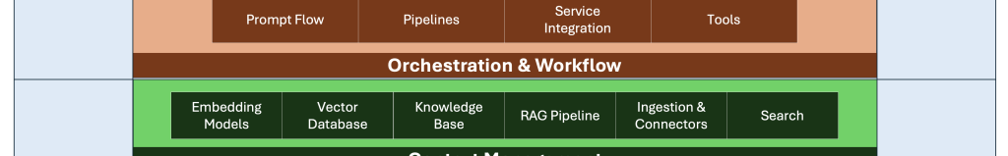
FlagOS & FlagTree Projects
FlagOS
FlagTree
Unified AI System Software Stack
Key Component of FlagOS Ecosystem
Supports Multiple AI Chips
Unified Compiler for Multiple AI Chips
Supports Multiple Computing Platforms
Code Generation & Optimization
Unified Programming Interface
Cross-Platform Compatibility
AI Software Stack Architecture
Image source: The New Stack
Notes:
单击此处添加文本

Slide 5
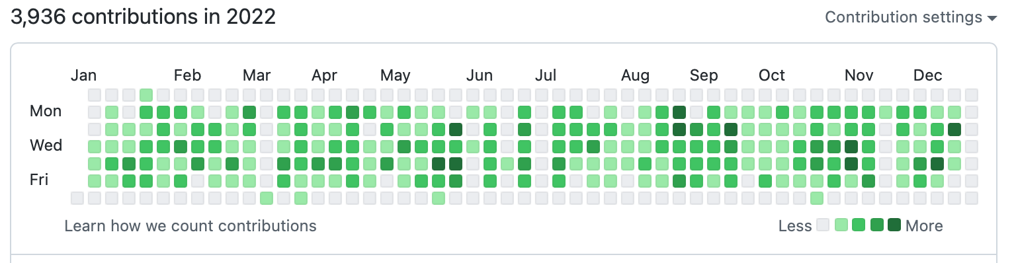
Why Contribute to Open Source?
Technical Growth
Read real-world industrial code and learn best coding practices
Learn large-scale system architecture design principles
Master collaborative development workflows and best practices
Career Development
Image source: GitHub Docs
GitHub open source contributions become your technical portfolio
Significantly boosts resume value and competitiveness
Build influence and network connections in the tech community
Notes:
单击此处添加文本

Slide 6
Open Source Collaboration Tools
Git
GitHub
Distributed Version Control System
Open Source Code Hosting Platform
Manage code version changes
Provides code hosting services
Supports branch-based development
Collaborative development toolset
Track modification history
Community communication platform
Core Concepts
Repository
Commit
Issue
Pull Request
Repository
Commit
Issue Tracking
Pull Request
Notes:
单击此处添加文本

Slide 7
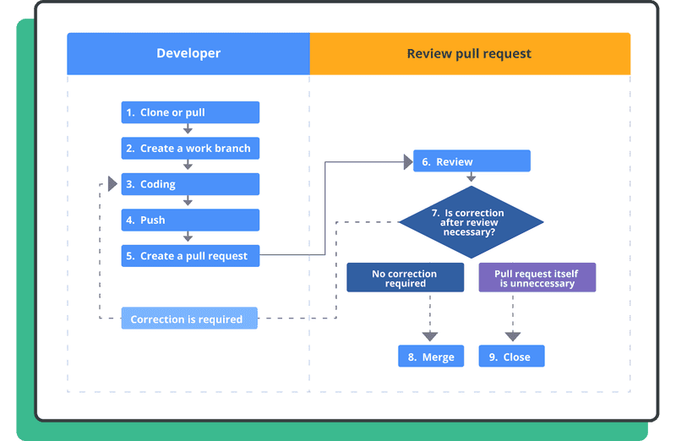
What is a Pull Request (PR)?
Role of a PR
Submit code changes
Request project maintainers to merge code
A key step in code review
Typical PR Workflow
1. Fork
2. Modify
3. Submit
4. Review
5. Merge
Repo
Code
PR
Code
Code
Image source: Nulab
Notes:
单击此处添加文本

Slide 8
Basic PR Submission Workflow for FlagOS
1
2
3
4
5
Fork FlagOS
Create a New
Modify Code
Commit
Submit
Repo
Dev Branch
or Docs
Commit Changes
Pull Request
PR Must Include
Description of Changes
Reason for Changes
Related Tests
Clearly describe what was changed in this PR
Explain why this modification is necessary
If applicable, provide test cases
Notes:
单击此处添加文本

Slide 9
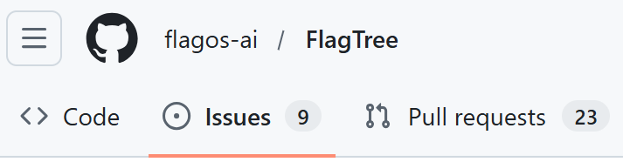
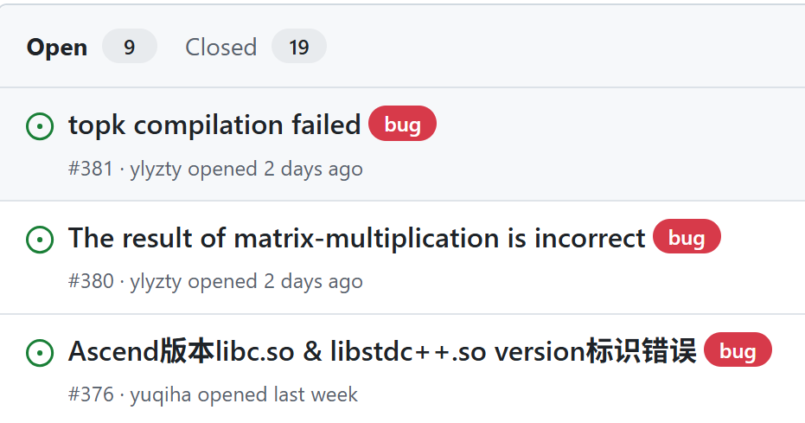
Issue: How to Report a Bug
When reporting a Bug in GitHub Issues, you need to provide:
Example Structure
Brief problem description
## Summary
Briefly describe the issue
Steps to reproduce
## Steps to reproduce
1. Step one
2. Step two
Accurate problem description
3. Step three
## Expected behavior
Description of expected behavior
Example code (if possible)
## Actual behavior
Description of actual behavior
ReferenceFlagTree：https://github.com/flagos-ai/FlagTree/issues
Notes:
单击此处添加文本

Slide 10
Code Contribution Requirements
When submitting a PR, you need to:
Before a PR can be merged:
Clearly describe the changes
Detail which files and features are affected by this change
State the reason for changes
Approved by at least one member
Explain why this modification is being made
Must pass code review by project maintainers
Provide test cases
Pass CI Checks
If possible, provide relevant test cases
Must pass automated tests and code checks
Wait for Team Member Review
Patiently wait for code review feedback
ReferenceFlagTree Contribution Guidelines:https://github.com/flagos-ai/FlagTree/blob/cc6a3158/CONTRIBUTING_cn.md
Notes:
单击此处添加文本

Slide 11
Importance of Code Standards
Large open source projects require unified code style — the foundation for code quality and collaboration efficiency
Improve Code Readability
Reduce Maintenance Cost
Facilitate Team Collaboration
Unified code style helps team members quickly understand code logic
Well-structured code is easier to maintain and extend, reducing technical debt
Unified standards reduce style disputes during code reviews
Common Standard Types
Code Format
Naming Rules
File Structure
Indentation, spaces, line breaks, etc.
Variables, functions, class naming
Directory organization, module division
Notes:
单击此处添加文本

Slide 12
Pre-commit Automated Checks
FlagTree uses pre-commit for code checking, automatically running checks before each commit
Installation
# Install pre-commit tool
Workflow
python3 -m pip install pre-commit
1
# Enter project directory
Write code
cd flagtree
2
# Install pre-commit hooks
git add files
pre-commit install
# Run checks manually
3
pre-commit auto-check
pre-commit
4
git commit
Purpose
Automatically check code format
Fix issues before committing
Notes:
单击此处添加文本

Slide 13
Python Code Linting Tool
ruff
Blazing-fast Python code linter
Features
Configuration
Python static code analysis
Line length: 120 characters
Detect syntax errors, style issues, and potential bugs
Auto-fix code issues
Auto-fix: Enabled
Supports auto-fixing many common issues
# Common ruff commands
ruff check . # Check all files in current directory
ruff check --fix . # Check and auto-fix issues
ruff check --select E,W,F . # Specify rule set
Notes:
单击此处添加文本

Slide 14
Python Code Formatting
yapf
Google's open source Python code formatter
Google Style
Auto-format
Maintain Consistency
Follows Google Python Style Guide
Format entire files with one command
Ensures uniform code style across the team
Usage Examples
# Format a single file (-i means in-place modification)
yapf -i file.py
# Format entire directory
yapf -i -r .
# Show diff only, do not modify file
yapf -d file.py
Notes:
单击此处添加文本

Slide 15
C++ Code Formatting
clang-format
LLVM project's C++ code formatter
Features
Advantages
LLVM Style
Improve Code Readability
Follows LLVM project code standards
Unified format makes code easier to read
Auto-format
Reduce style disputes
Automatically formats C++ code
Automation eliminates manual style debates
# Common clang-format commands
clang-format -i file.cpp # Format a single file
clang-format -i *.cpp *.h # Format multiple files
clang-format --style=LLVM -i file.cpp # Specify style
Notes:
单击此处添加文本

Slide 16
CI/CD Fundamentals
CI/CD
Continuous Integration / Continuous Deployment
Continuous Integration / Continuous Deployment
Role of CI
Role of CD
Automated code build
Automated software deployment
Automatically compiles the project on each commit
Automatically deploys code that passes tests
Automated test execution
Rapid delivery
Runs unit tests and integration tests
Shortens time from development to production
In open source projects, CI/CD is used to ensure code quality
Notes:
单击此处添加文本

Slide 17
FlagTree CI/CD Architecture
FlagTree provides a unified CI pipeline for different hardware, ensuring cross-platform compatibility
Supported Backends
NVIDIA
AMD
Iluvatar
Moore Threads
MetaX
Huawei Ascend
Cambricon
And more...
Goal
Ensure all hardware platforms run correctly and provide a unified development experience
Notes:
单击此处添加文本

Slide 18
CI Workflow Steps
Typical CI Workflow
Setup
Checkout
Docs
Build Project
Test
Setup
Checkout
Docs
Build
Test
Build Example
# Build project using 32 parallel jobs
MAX_JOBS=32 python3 -m pip install . --no-build-isolation
# Parameter description:
# MAX_JOBS=32 - number of parallel compile jobs
# --no-build-isolation - do not use isolated build environment
Notes:
单击此处添加文本

Slide 19
Unit Testing
After installation, run tests to verify code correctness
NVIDIA / AMD
Other Backends
# Enter unit test directory
# Enter backend test directory
cd python/test/unit
cd third_party/backend/python/test/unit
# Run pytest tests
# Run pytest tests
pytest -s
pytest -s
pytest -s flag shows test output for easier debugging
Notes:
单击此处添加文本

Slide 20
Security Code Scanning
The project is configured with automated code scanning to continuously monitor codesecurityandcompliance
Trigger Conditions
Scan Results
Push to main branch
Generate detailed reports
Triggered when main branch code is updated
Contains discovered issues and recommendations
Pull Request
Automatic notification
Scan triggered when a PR is submitted
Provides timely feedback to developers
Purpose
Improve security
Ensure code compliance
Promptly detect potential security vulnerabilities
Ensure compliance with open source license requirements
Notes:
单击此处添加文本

Slide 21
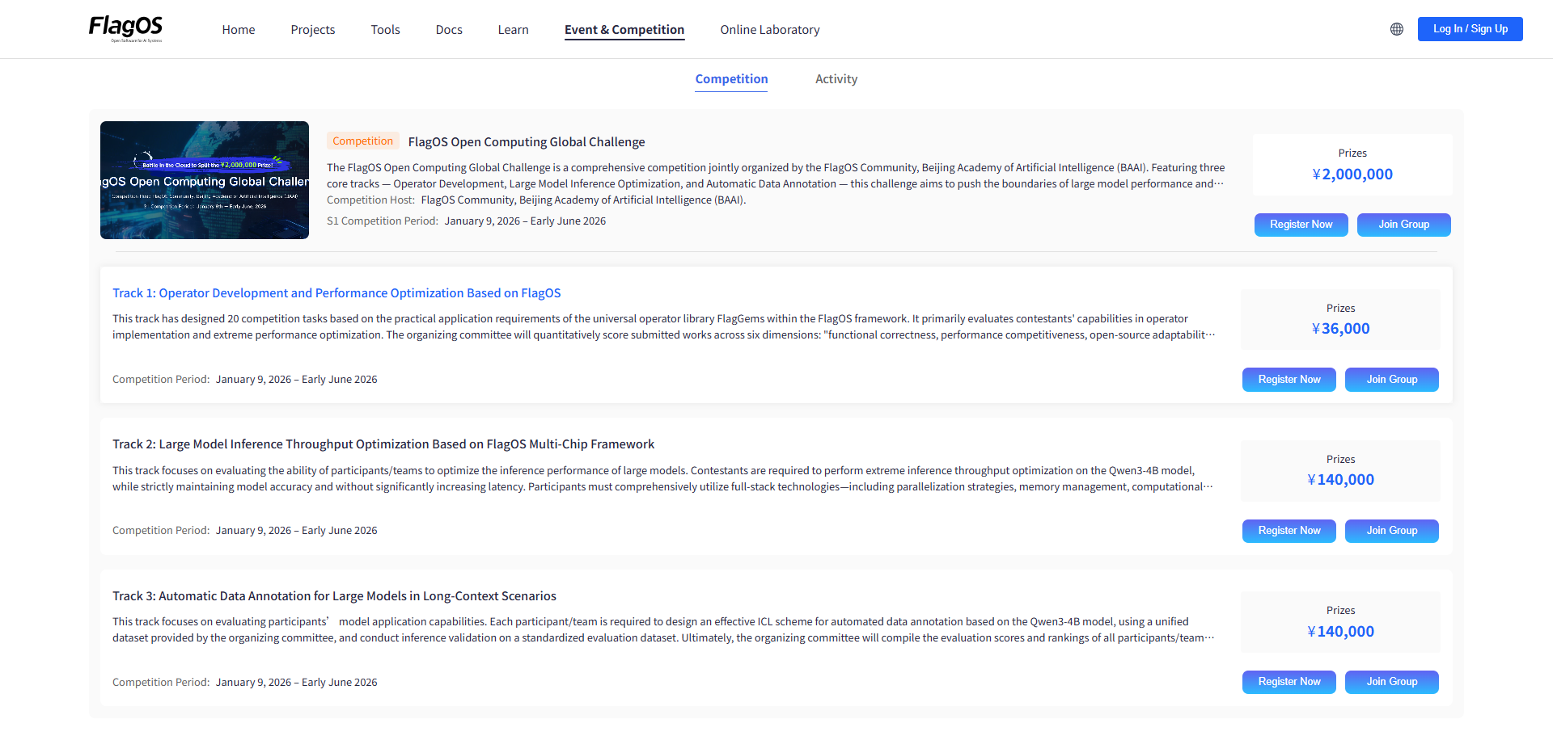
FlagOS Open Computing Global Challenge
Organizers
FlagOS Community
Beijing Academy of Artificial Intelligence (BAAI)
Official Website
Official Introduction:https://flagos.io/RaceDetail
Registration：https://flagos.io/events
Notes:
单击此处添加文本

Slide 22
Course Assignment
Requirements
Submission
Each student must:
PR Link
1
Fork the FlagOS repository
Change Description
2
Submit one Pull Request
Learning Goals
Familiarize with GitHub open source workflow
Task Type (choose one):
Documentation Fix
Experience real open source collaboration
or
Understand CI/CD and code standards
Bug Fix (minor fix)
Wishing all students success in completing the assignment and starting your open source journey!
Notes:
单击此处添加文本

Slide 23

The Solution: FlagOS, a Unified AI Software Stack

Slide 24








https://space.bilibili.com/3546791834290849
https://github.com/flagos-ai
https://www.zhihu.com/people/95-22-20-18/posts
https://flagos.io/Home

Slide 25

Thanks for your time！

